Slide 1

Computer Engineering Department
A.P. Shah Institute of Technology
G.B.Road,Kasarvadavali, Thane(W), Mumbai-400615
UNIVERSITY OF MUMBAI
Academic Year 2022-2023

Slide 2
A Major Project Presentation on Crop and Weed Detection
Submitted in partial fulfillment of the degree of
Bachelor of Engineering(Sem-VIII)
In
Computer Engineering
Under the Guidance of
Name of Guide Prof.Sachin Takmare

Slide 3


Slide 4
1.Project Conception and Initiation

Slide 5

1.1 Abstract
Sesame is a high oil content crop from which prized oil is extracted. Hence, Sesame plays an important role in the development of a nations economy.
In order to increase the growth of sesame in the sesame crop it is necessary to detect the weed in the sesame crop and the barren land to minimize the growth of weed so that the growth of the sesame can be increased.
We proposed a web application to detect and localize the crop, by training the datasets using RCNN & SVM. Using the Bounding box technique the image is detected.

Slide 6

1.2 Objectives
To implement a weed detection system.
To implement a crop detection system.
To suggest measures to remove the weed identified by the system.

Slide 7

1.3.a Literature Review
In most cases, the weed and crop may not have distinguishing features and it is extremely difficult to distinguish the weed and the crop using a single feature. It is necessary to develop techniques that can look at all the available distinguishing features. Pattern recognition techniques such as Regions with Convolutional Neural Networks (R-CNN) and Support Vector Machine (SVM) can combine several such features to distinguish the weed or crop.

Slide 8
1.3.b Literature Survey Table
AUTHOR | TITLE | SOURCE
C.andrea | Precise Weed and Maize Classification through Convolutional Neural Network. | https://www.semanticscholar.org/paper/Precise-weed-and-maize-classification-through-Andrea-Daniel/0ed360773188436b297250bcdc1eb28d5f00709f/
ODSC-Open Data Science | Overview of the YOLO Object Detection Algorithm | https://odsc.medium.com/overview-of-the-yolo-object-detection-algorithm-7b52a745d3e0/
Sarmad hamid | Detection of Weed and Wheat Using Image Processing. | https://ieeexplore.ieee.org/abstract/document/8629137/authors#authors/
C.Thirumari selvi | Weed Detection in Agriculture fields using Deep Learning Process | https://ieeexplore.ieee.org/document/9441683/authors#authors/
John Potgieter | Weed Detection by Faster RCNN Model. | https://www.mdpi.com/2073-4395/12/7/1580/

Slide 9

1.4 Problem Definition
To detect Crop and Weed in a farm from given input image and suggest measures to remove the weed in order to improve the agricultural yield and crop quality using Regions with Convolutional Neural Network (R-CNN) and Support Vector Machine (SVM)

Slide 10

1.5 Scope
We can add more crops once the datasets for the same are available.
We can provide the details on the best agricultural practices to do on the crop in order to improve crop quality

Slide 11

1.6 Technology stack
Anaconda Navigator
Anaconda Command Prompt
Jupyter Notebook
Web Browser
Python version 3

Slide 12

1.7 Benefits for Environment & Society
Helps in saving the Crops from harmful weed
Since Crops can be produced in higher quantities with good quality , this will ultimately help to improve a nations economy as crops play an important role in it.
As weed will be reduced from the environment the water and nutrients it absorbs will ultimately pass on to the trees and crops nearby it.
This will result in a better quality environment with no waste of natural resources.

Slide 13

2. UML Diagrams

Slide 14
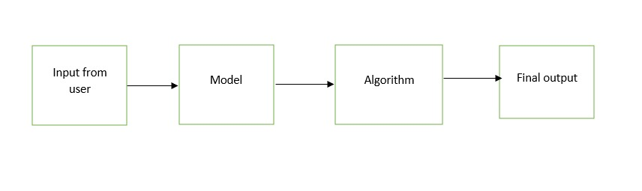
2.1 Data Flow Diagram (DFD)

Slide 15
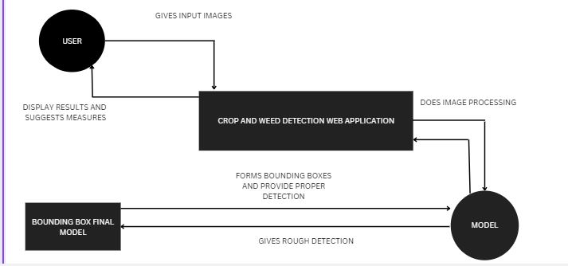
2.2 Data Flow Diagram (Level 1)

Slide 16
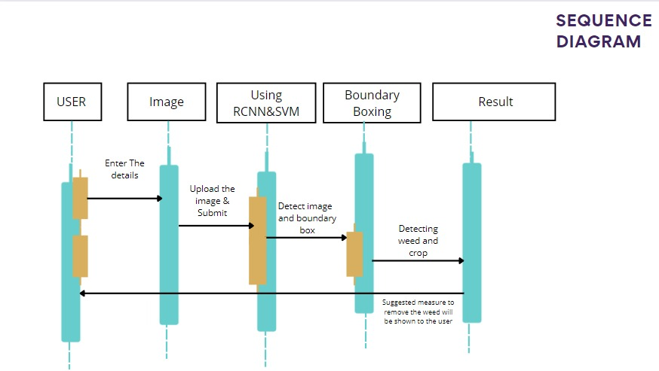
2.3 Sequence Diagram

Slide 17
3.Implementation

Slide 18
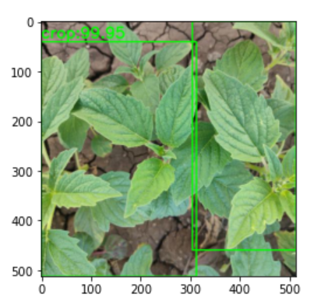
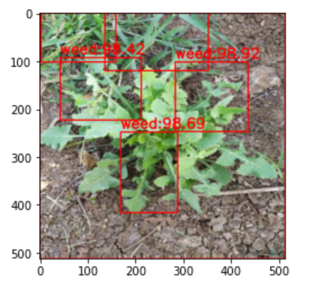
IMPLEMENTATION
CROP
WEED

Slide 19
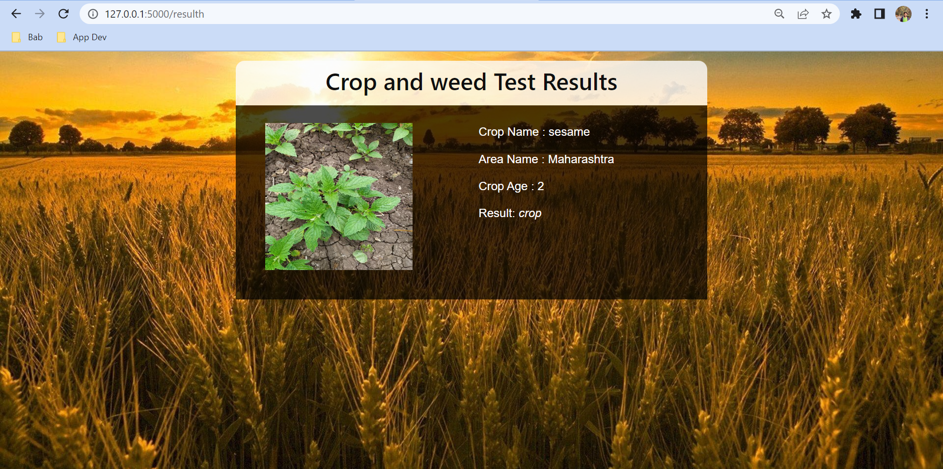
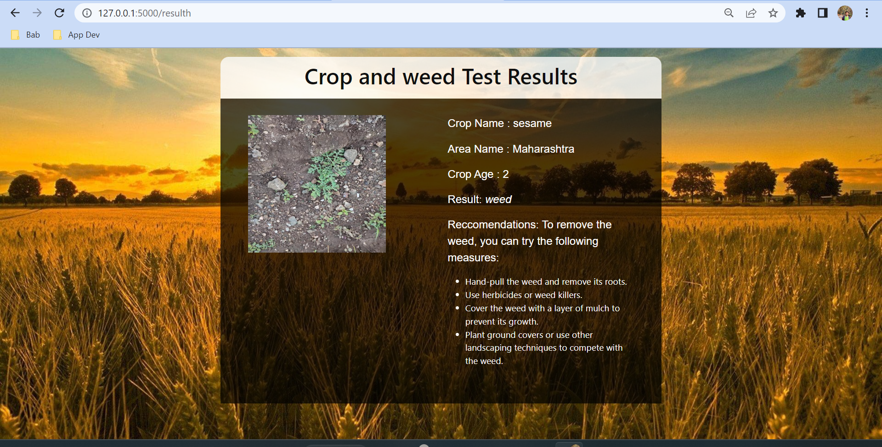
IMPLEMENTATION
CROP
WEED

Slide 20
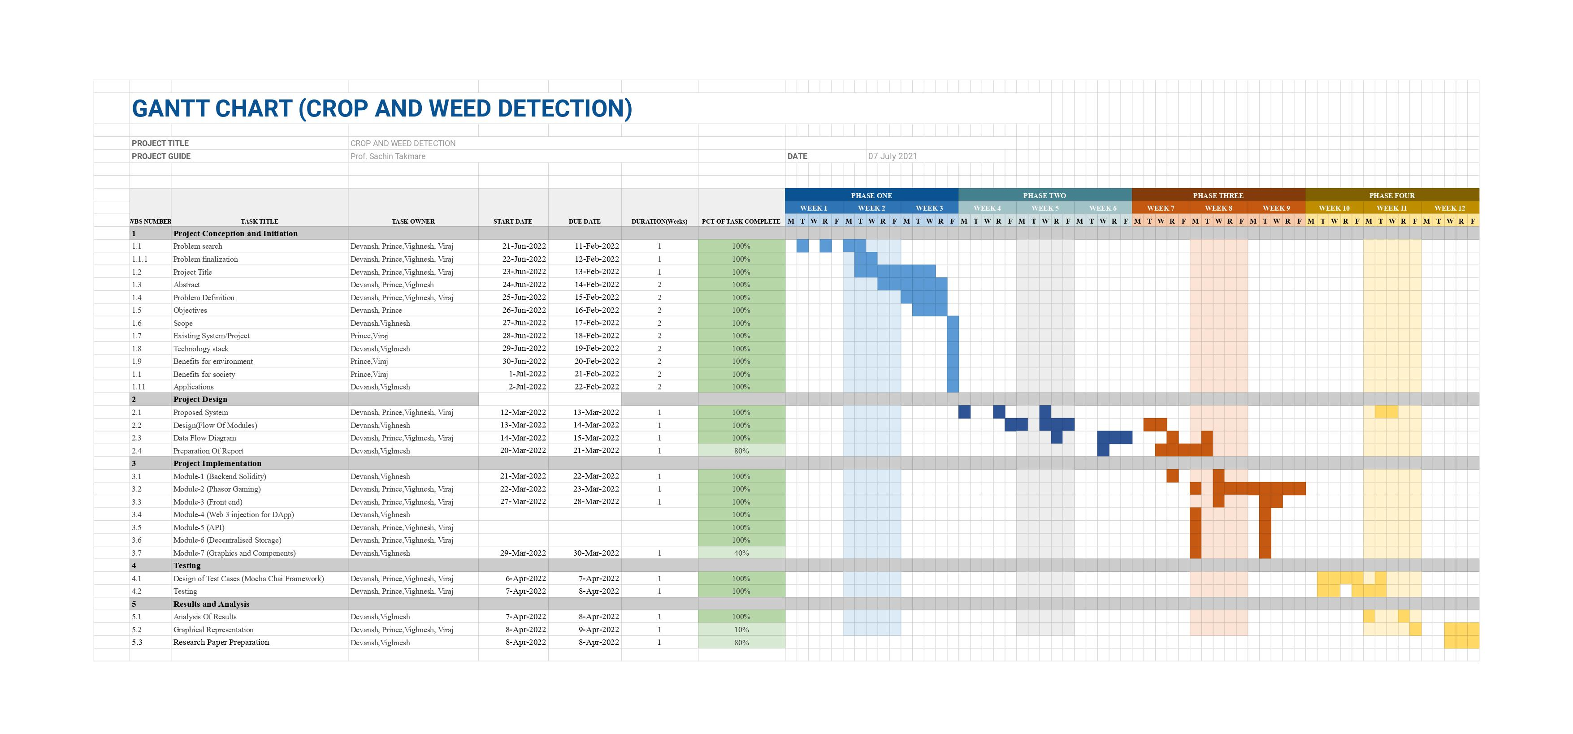
Project Plan

Slide 21

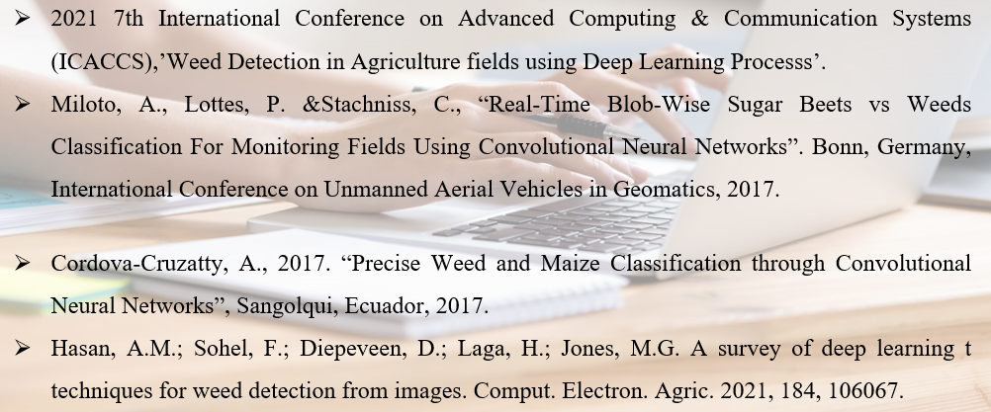
6. References

Slide 22

THANK YOU!

